Slide 1

Design and development of Travel Guide using Wikipedia text
Under the guidance of –
Mr. Sagar Patil
Mr. Sudhanshu Trivedi
Internal guide-
Dr. Anju S.Pillai
Assistant Professor (SG)
EEE Department
Amrita Vishwa Vidyapeetham,
Coimbatore.
By-
Mrs. Sejal Badgujar
MTech, II year ,2018-20
EEE Department
Amrita Vishwa Vidyapeetham,
Coimbatore

Slide 2
Overview
Introduction
Objective
System Overview
Methodology
Work done
Result
Conclusion
References

Slide 3
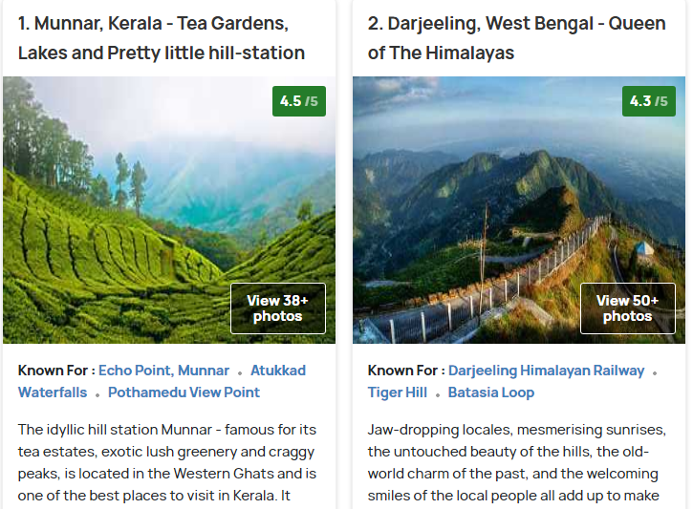
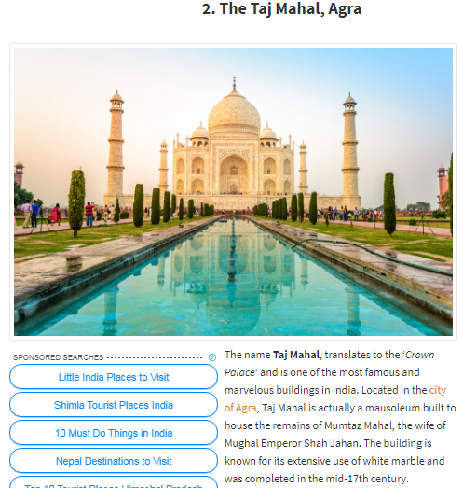
Introduction
https://www.holidify.com/collections/tourist-places-in-india
http://www.transindiatravels.com/india/best-places-to-visit-in-india/
It is tedious to go to different sites and read all the information
Wikipedia contains most of the details of each and every place
Source: Google

Slide 4
Objective
To design and develop a Travel Guide with the help of Wikipedia data using topic modeling and word embedding

Slide 5
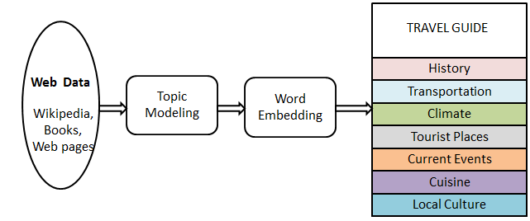
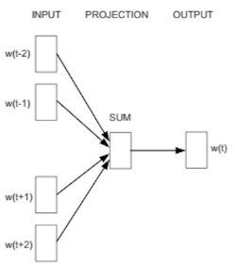
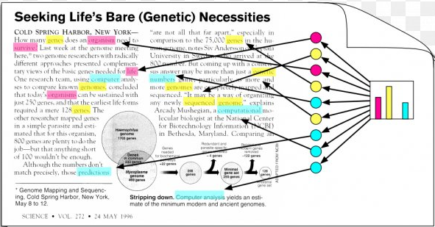
OVERVIEW of Project

Slide 6
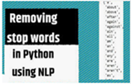
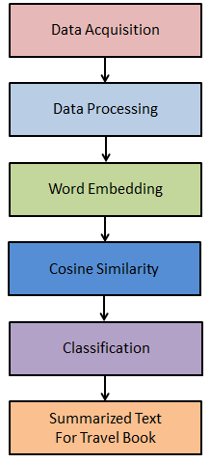
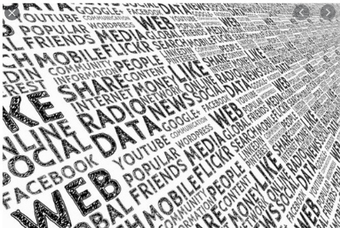
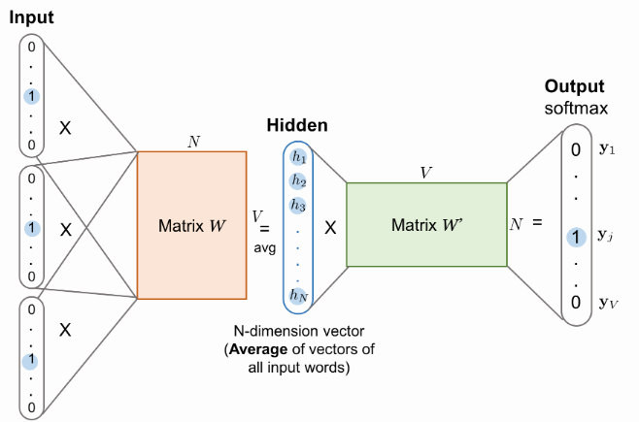
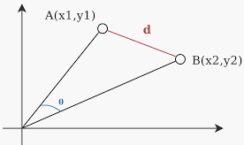
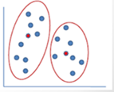

Methodology

Slide 7
Work Done
Data acquisition - Data is fetched from Wikipedia and stored in text file for a sample Wikipedia page (e.g. Sinhagad)
Data filtering - Stop words are removed.
Topic modeling - Done using Latent Dirichlet Allocation (LDA)
Word embedding - Word vectors and document vectors are formed
Cosine similarity – Similarity between each two vectors is calculated using word vector and average vector.
Similarity set are formed for each sentence by applying threshold to Cosine similarity and fetching most similar sentences
Clustering - Similarity sets are clustered to get summarize the text.
Timelines in terms of year are taken out from data, using vectors proximity words are calculated to get event happened in the year
Tagging – Name entity recognition, every word is tagged with Person, Date etc.

Slide 8
SOFTWARE REQUIREMENT
Python IDLE
Sklearn
Nltk
Gensim
Pandas
Numpy
Spacy
Jupyter notebook

Slide 9
STEP 1: DATA ACQUISITION
API used:
Wikipedia – to get wikipedia data
Beautiful Soup - HTML and XML files parser
NLTK- Natural language toolkit
Wikipedia data is fetched and parse as html stored in a text file.

Slide 10

STEP 2: DATA Processing
A stop word is a commonly used word that a search engine has been programmed to ignore.
Generally, the most common words used in a text are “the”, “is”, “in”, “for”, “where”, “when”, “to”, “at” etc.
Stopwords are the most common words in any natural language.
Stopwords might not add much value to the meaning of the document

Slide 11
Topic modeling
Extract the bunch of words in large clusters of texts
Topic modeling is an ‘unsupervised’ machine learning technique (one that doesn’t require training).
LDA and its use
LDA assumes documents are produced from a mixture of topics.
Those topics then generate words based on their probability distribution.
Given a dataset of documents, LDA backtracks and figure out what topics would create those documents in the first place.

Slide 12
STEP 3: WORD EMEDDING
Word2vec
They are vector (numeric) representations of a particular word
Word2vec is a two-layer neural network that processes text by “vectorizing” words
They can be implemented in two types
Continuous bag of words : Many similar word to predict one word
Skip gram : One word to predict all surrounding words
Doc2vec
Doc2vec is to create a numeric representation of a document
Encapsulate different relations between words, like synonyms, antonyms, or analogies
Notes:
Diff:
While Word2Vec computes a feature vector for every word in the corpus, Doc2Vec computes a feature vector for every document in the corpus.
While Word2Vec works on the intuition that the word representation should be good enough to predict the surrounding words, the underlying intuition of Doc2Vec is that the document representation should be good enough to predict the words in the document.

Slide 13
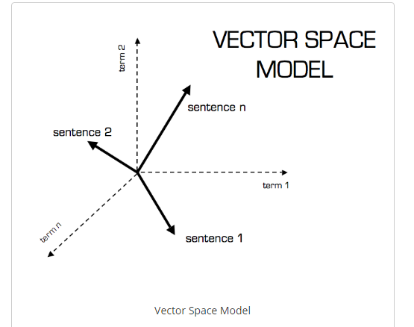

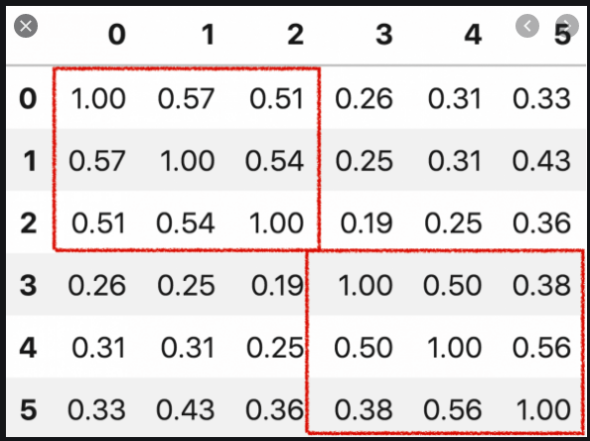
STEP 4: Cosine similarity
The cosine similarity between two is a measure that calculates the cosine of the angle between them.
Cosine similarity between every sentence with every other sentence is calculated.
Most similar sentences are extracted for every sentence, by putting threshold to get similarity sets.
From similarity sets, summarized data is calculated.

Slide 14
STEP 5: CLASSIFICATION
1. K- means Clustering
Similarity sets are clustered in k clusters by applying k-means clustering.
Input the k-means clustering is average of vectors of similarity sets.
Each clustered text is observed for further studies.
2. Timeline wise Classification
Timelines i.e. years present in the text are extracted.
By using vectors, proximity words for those years are calculated to get events.
Wordcloud is plotted year wise

Slide 15
STEP 5 : Text Summarization
Summarized text are calculated from:
Similarity sets
K-means clusters
Events from proximity of timelines
With summarized text:
Over all meaning of large data can be presented
Events happened in the year can be detected

Slide 16
Tagging
Name entity recognition classify named entity in text into pre-defined categories such as the
names of persons,
organizations,
locations,
expressions of times,
quantities,
percentages, etc.
NER is used in many fields in Natural language processing (NLP), and it can help answering many real-world questions.

Slide 17
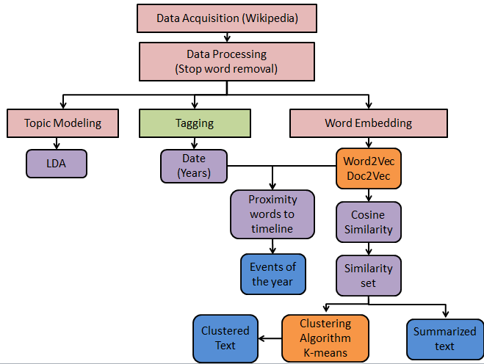

Overall Work DONE

Slide 18

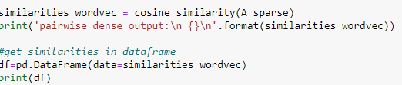
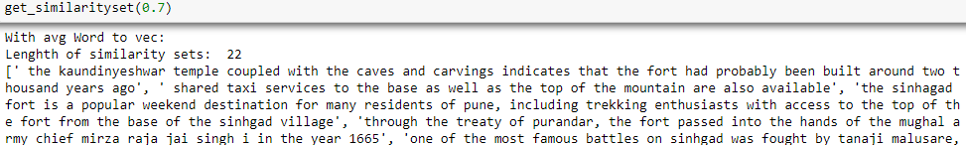
RESULTS : Similarity sets and summarized text

Slide 19
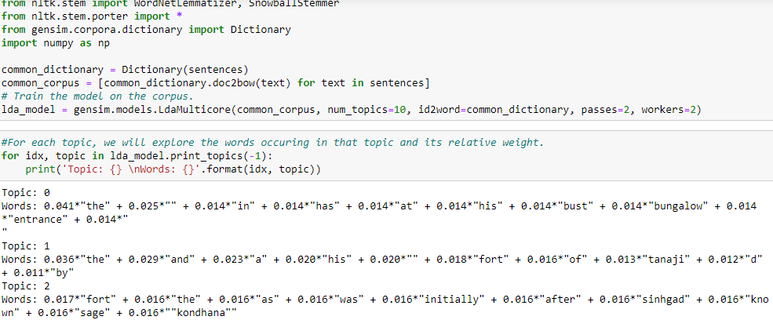
RESULTS : Topic modeling

Slide 20
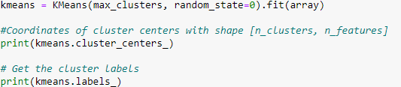
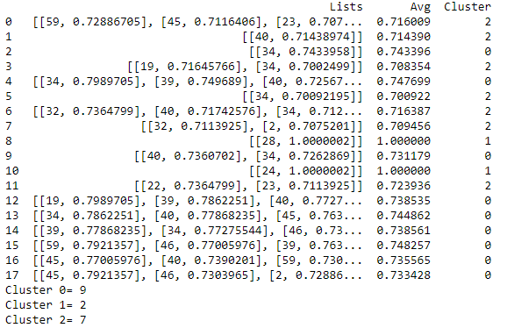
RESULTS : CLUSTERING K-means

Slide 21
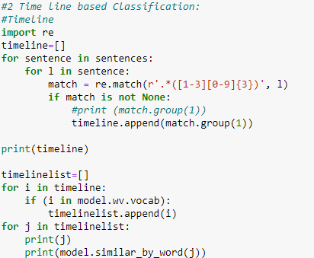
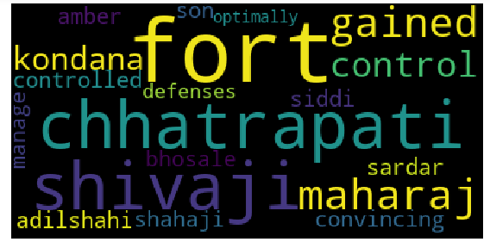
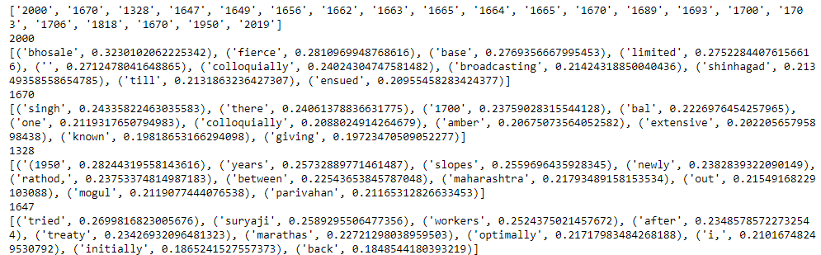
RESULTS : Timeline wise classification

Slide 22
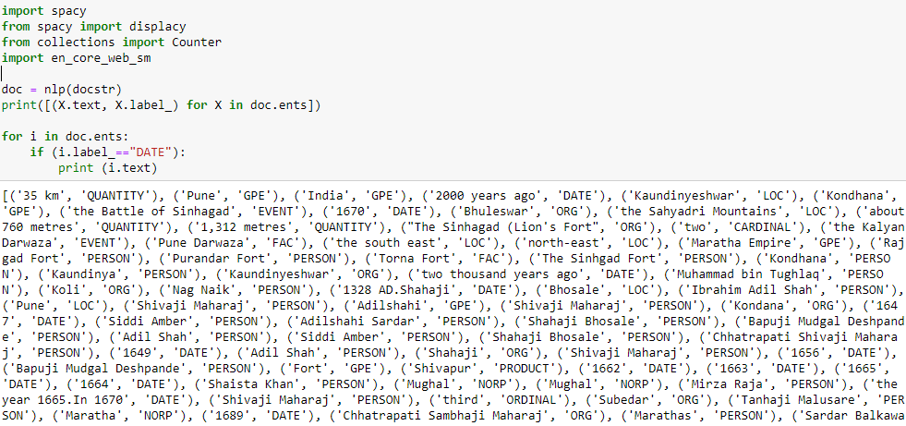
RESULTS : Tagging

Slide 23
CONCLUSION
Data fetching is done for sample site as Sinhagad fort.
Data filtering is done by removing stop words.
Topic modeling is done by LDA
Word embedding is done using word2vec and doc2vec
Text is summarized to be used in travel guide formation by cosine similarity sets, k-means clustering
Year wise events are fetched by timeline wise classification.
Tagging is done for name entity recognition.
All these modules will be further used in the final construction of the project.

Slide 24
TimeLine
Month | March | April | May | June | July
Data Acquisition
Data Pre-processing
Word Embedding
Clustering
Preparing travel book

Slide 25
REFERENCES
[1] George Forman, Evan Kirshenbaum “Extremely Fast Text Feature Extraction for Classification and Indexing”, HP Laboratories, HPL-2008
[2] Hong Liang, Xiao Sun, Yunlei Sun and Yuan Gao,” Text feature extraction based on deep learning: a review”, Liang et al. EURASIP Journal on Wireless Communications and Networking, 2017
https://towardsdatascience.com/
https://radimrehurek.com/gensim/
https://github.com/
https://www.wikipedia.org/
https://www.machinelearningplus.com/

